Slide 1

Building a Liar’s Dice AI
Andrew Yang, Peiyu Zhong, Ruipei Huang, Thomas Li

Slide 2
Outline
Game Rules
Front-End Development
Algorithm

Slide 3
Game Rules

Slide 4
Game Rules
To begin each round, all players roll their dice simultaneously and keeping them hidden from the other players.
The first player then states a bid consisting of a face (“2's”, “5's”, etc.) and a quantity. The quantity represents the player's guess as to how many of each face have been rolled by all the players at the table, including themselves. (e.g., “five 2’s”)
Each subsequent player can either then make a higher bid (e.g., “six 2's” or “five 3’s”), or they can challenge the previous bid.

Slide 5
Game Rules Continued
If the player challenges the previous bid, all players reveal their dice. If the bid is matched or exceeded, the bidder wins. Otherwise the challenger wins.
The loser of the previous round begins the next round.

Slide 6
Game Rules Continued
Wild ones: Ones count as the face of the current bid (e.g., 11223 can be counted as 22223, 22333, 22344, 22355, and 22366)
Five of a kind: 5 dice with same face can be counted as 6
Reroll: If all dice have different faces, you may reroll

Slide 7
App Development

Slide 8
App Development
Designed a GUI using Tkinter Library in Python
Functionality
Created databases that housed the AI algorithm and data
Implemented databases by connecting the frontend and backend

Slide 9
Algorithm

Slide 10
Probabilities
Pr(opponent has at least 1 dice that is the same as our bid) | 1 - (₅C₀ * ⅓⁰ * ⅔⁵) = 0.8683
Pr(opponent has at least 2 dice that are the same as our bid) | 1 - (₅C₁ * ⅓¹ * ⅔⁴ + ₅C₀ * ⅓⁰ * ⅔⁵) = 0.5391
Pr(opponent has at least 3 dice that are the same as our bid) | 1 - (₅C₂ * ⅓² * ⅔³ +₅C₁ * ⅓¹ * ⅔⁴ + ₅C₀ * ⅓⁰ * ⅔⁵) = 0.2099
Pr(opponent has at least 4 dice that are the same as our bid) | ₅C₄ * ⅓⁴ * ⅔¹ + ₅C₅ * ⅓⁵ * ⅔⁰ = 0.0453
Pr(all of opponent’s dice are the same as our bid) | ₅C₅ * ⅓⁵ * ⅔⁰ = 0.0041

Slide 11
How we build the AI?
Record the bid of each round
Check if the player was bluffing (fewer than half of the bid) after all dice are revealed
Alg1 counts the total probability of bluffing after certain cases
Alg2 creates a Markov Chain based on the data collected
Guess if the player is bluffing in the current round
Make decisions according to its own dice and speculation of player’s dice

Slide 12
Four Different Cases
Start -> if game[0][0] == 1:
Add -> if game[i][2] == game[i - 2][2]:
Switch -> if game[i][2] != game[i - 2][2] and game[i][2] != game[i - 1][2]:
Call -> if game[i][2] != game[i - 2][2] and game[i][2] == game[i - 1][2]:
Markov Chain only uses Start and Switch for the initial state

Slide 13
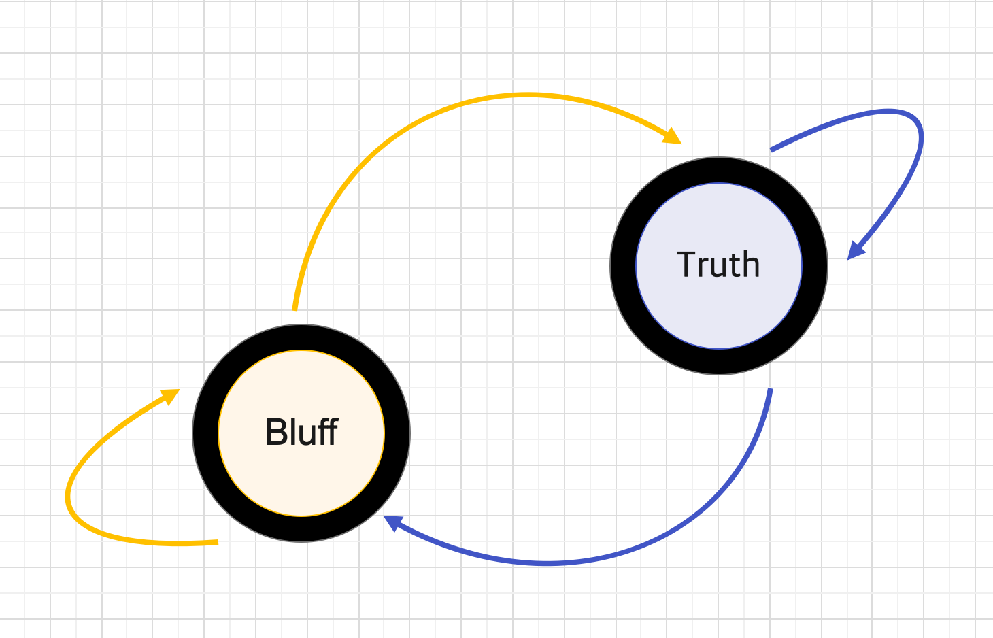
 | Bluff | Truth
Bluff | 0.5 | 0.5
Truth | 0.5 | 0.5

Slide 14
Improvements of AI
Let AI against AI (Monte Carlo Simulation)
Invite friends to play against AI and collect data
Try different parameters and repeat

Slide 15
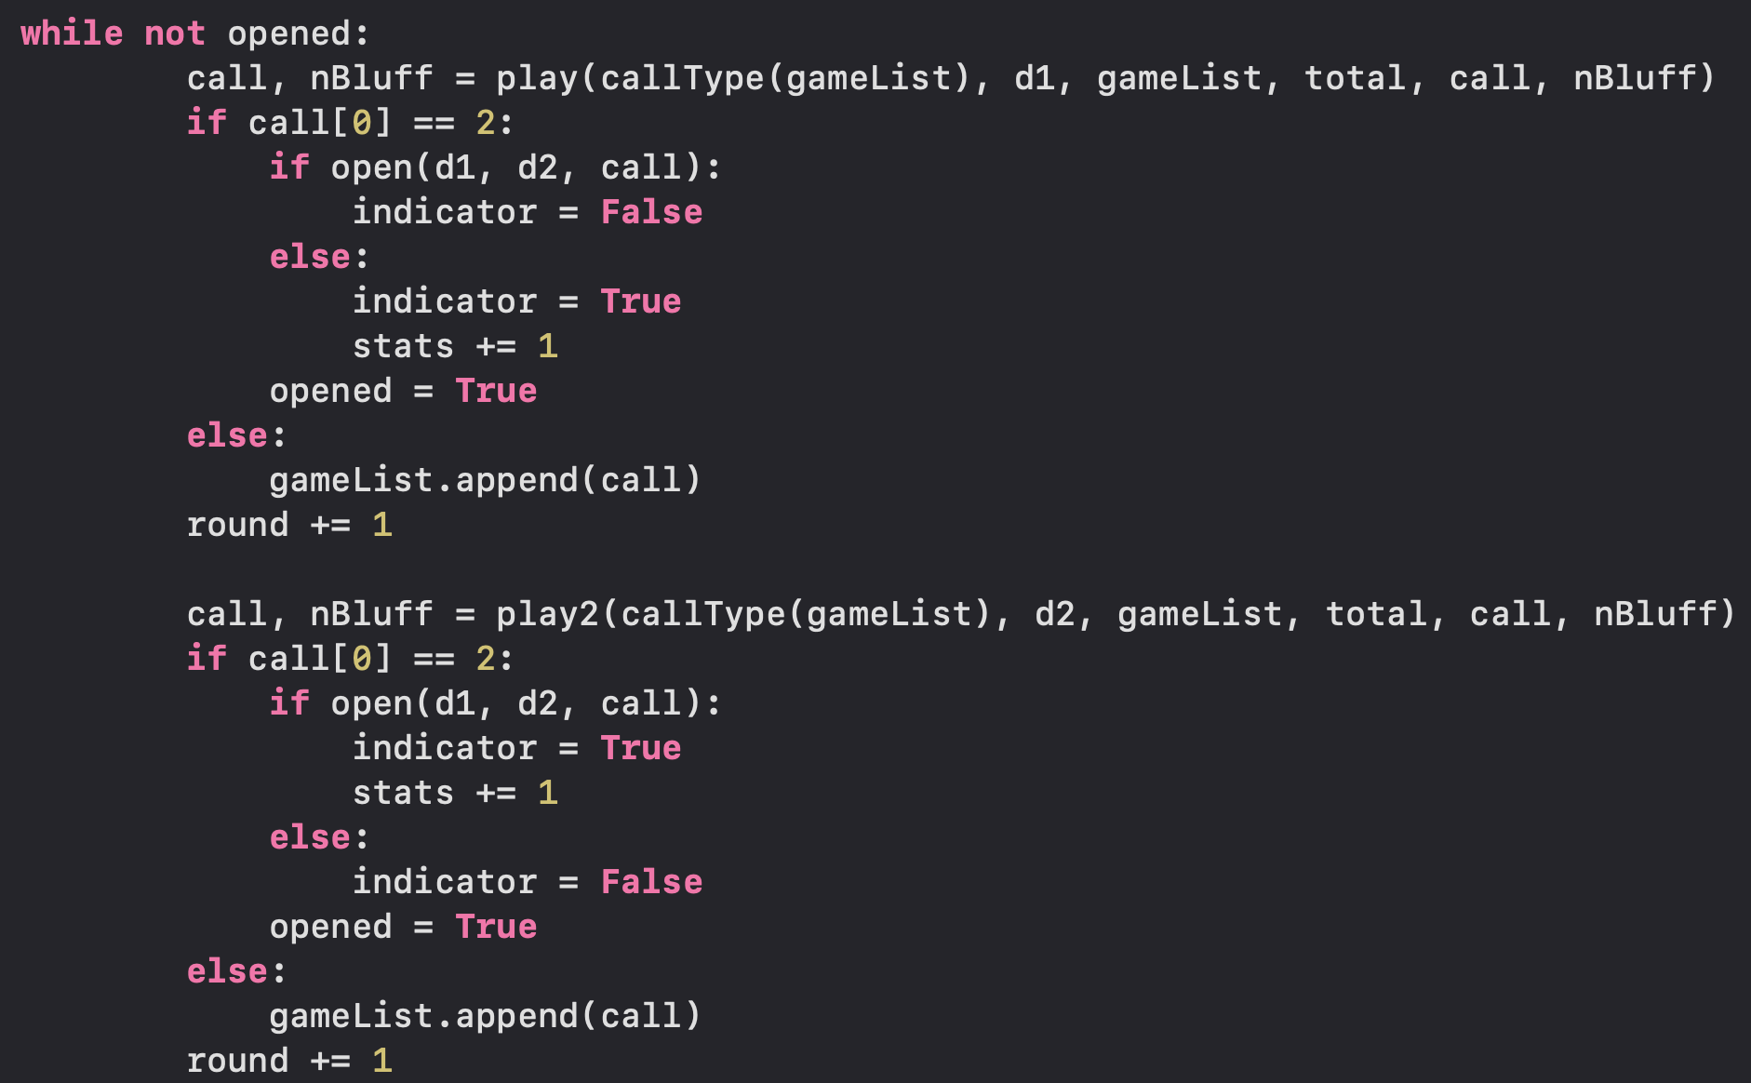
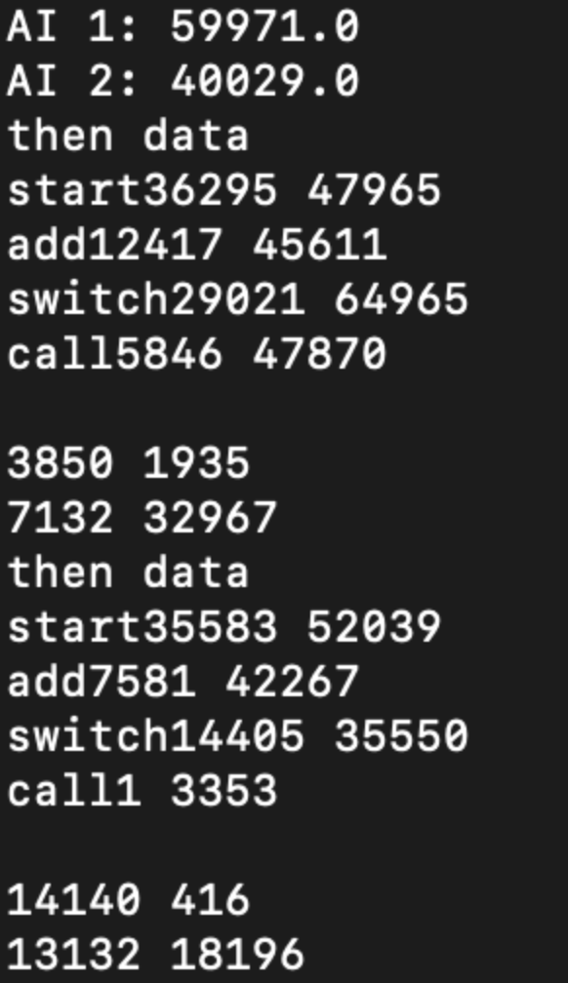

Slide 16
Thanks for listening!

